Slide 1
Software Construction Laboratory CS35L – Lab 1
Course Webpage: https://web.cs.ucla.edu/classes/fall18/cs35L/index.html
TA: Zhiyi Zhang
Email: zhiyi@cs.ucla.edu
Webpage: https://zhiyi-zhang.com

Slide 2
Session 10-2
Week 5: CPU Mode, System Call
Week 6: Multithreading
Week 7: Linking
Week 8: Security, SSH
Week 9: Git

Slide 3
Week 5

Slide 4
Processor/Operating/CPU Modes
Operating systems place restrictions on the type and scope of operations that can be performed by certain processes
only highly trusted kernel code is allowed to execute in the unrestricted mode
Notes:
integer factorization, discrete logarithm

Slide 5
User Mode v.s. Kernel Mode
User Mode (mode bit = 1)
restricted access to system resources
CPU restricted to unprivileged instructions and a specified area of memory
Kernel Mode (mode bit = 0)
unrestricted access
CPU is unrestricted, can use all instructions, access all areas of memory and take over the CPU anytime

Slide 6
Why Dual-mode Operation?
System resources are shared among processes and the OS must ensure
Protection: an incorrect/malicious program cannot cause damage to other processes or the system as a whole
Prevent processes from accessing illegal memory and modifying kernel code and data structures
Prevent processes from performing illegal I/O operations
Fairness: Make sure processes have a fair use of devices and the CPU
Prevent a process from using the CPU for too long

Slide 7
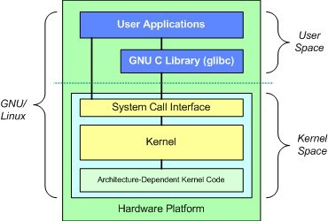
Only Kernel Code is Trusted
Core of OS software executing in kernel/supervisor state
Trusted software:
Software who manages hardware resources (CPU, Memory and I/O)
Software who implements protection mechanisms that could not be changed through actions of untrusted software in user space
System call interface is a safe way to expose privileged functionality and services of the processor

Slide 8
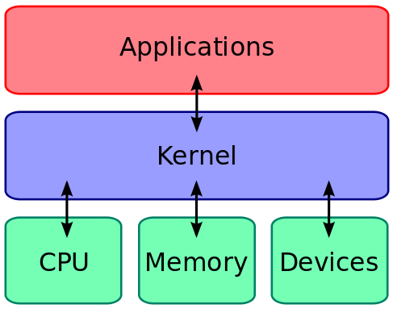
How User Mode Processes Use Kernel Space?
The kernel executes privileged operations on behalf of untrusted user processes
The way is using system calls

Slide 9
When System Calls Are Made
When a system call is made, the program being executed is interrupted and control is passed to the kernel
If operation is valid, the kernel performs it

Slide 10
System Call Overhead
System calls are expensive and can hurt performance
The system must do many things
Process is interrupted & computer saves its state
OS takes control of CPU & verifies validity of operations
OS performs requested action
OS restores saved context, switches to user mode
OS gives control of the CPU back to user process

Slide 11
Examples
Process Control | fork(), exit(), wait()
File Manipulation | open(), read(), write(), close()
Device Manipulation | ioctl(), read(), write()
Information Maintenance | getpid(), alarm(), sleep()
Communication | pipe(), shmget(), mmap()
Protection | chmod(), umask(), chown()

Slide 12
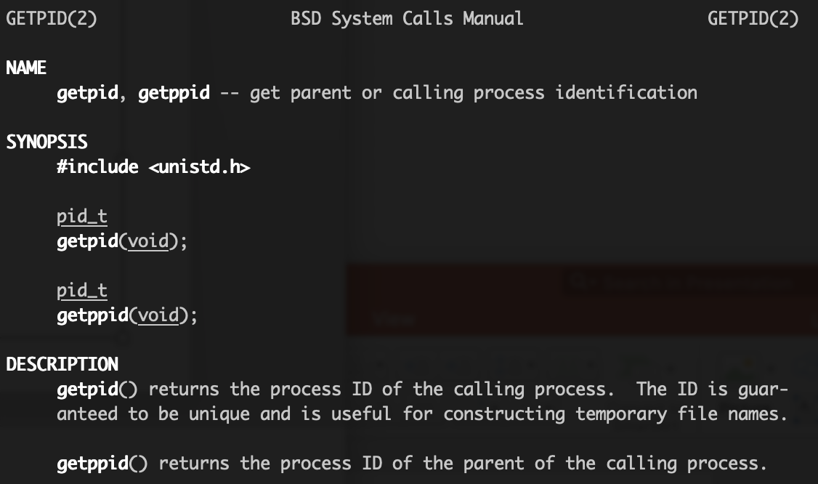
How to Use System Calls?
Use man to check the system calls
Examples:
getpid(), getppid()
read(), write(),
open(), close()
fstat(),
dup()

Slide 13
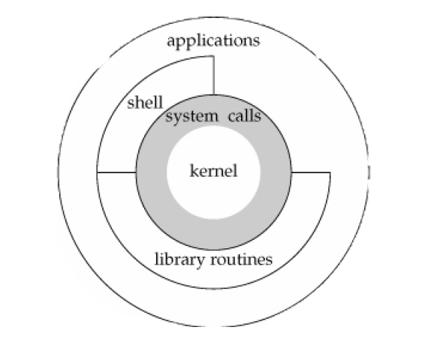
System Call Through Library Functions
Functions that are a part of standard C library
To reduce system call overhead, use equivalent library functions
getchar, putchar vs. read, write (for standard I/O)
fopen, fclose vs. open, close (for file I/O), etc.
How do these functions perform privileged operations?
They make system calls
So what’s the difference?

Slide 14
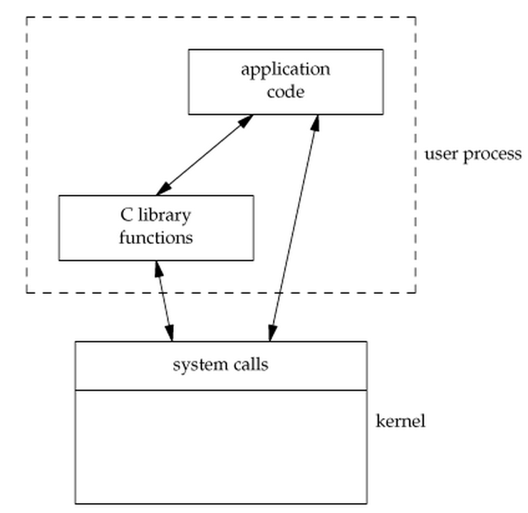
Why Bother?
Libraries wrap the system call and optimize the performance
Usually less system calls
Non-frequent switches from user mode to kernel mode
Therefore less overhead and better developing experiences.

Slide 15
Library Function Call Examples
getchar, putchar vs. read, write (for standard I/O)
fopen, fclose vs. open, close (for file I/O)
malloc vs. brk sbrk (for memory allocation)
…

Slide 16
Case Study: Why fopen Is Better Than open
fopen provides you with buffered I/O while open is unbuffered I/O
Every byte is read/written by the kernel through a system call in unbuffered I/O while buffered I/O collect as many bytes as possible (in a buffer) and read more than a single byte (into buffer) at a time and use one system call for a block of bytes
fopen returns FILE struct which can also be used by other stdio functions like fscanf()
fopen can work across platforms (fopen can work on platforms that does not use open, e.g., some old versions of C)
Notes:
Buffered I/O decreases the number of read/write system calls and the corresponding overhead

Slide 17
Week 6

Slide 18
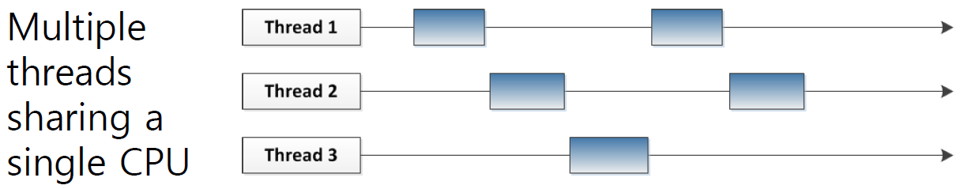
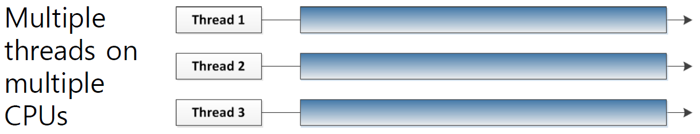
Multithreading with single/multiple CPUs

Slide 19
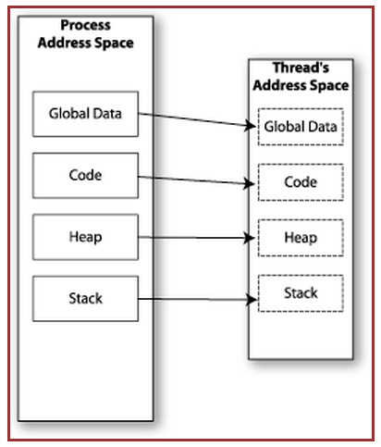

Memory Layout: Single-Threaded Program

Slide 20
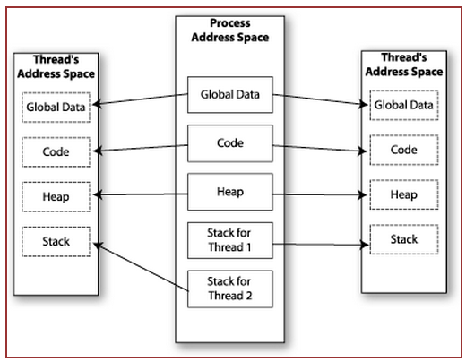

Memory Layout: Multithreaded Program

Slide 21
thread
A thread is a single sequence stream within in a process.
A thread share the code section, data section, and heap space with other threads.
A thread has its own stack space, register set.

Slide 22
Multithreading
Threads share all of the process's memory except for their stacks. Therefore, data sharing requires no extra work (no system calls, pipes, etc.)
Shared memory makes multithreaded programming
Powerful: can easily access data and share it among threads
More efficient: No need for system calls when sharing data and thread creation and destruction are less expensive than process creation and destruction
Non-trivial: Have to prevent several threads from accessing and changing the same shared data at the same time (synchronization)

Slide 23
Compile your c program with pthread
#include <stdio.h>
#include <pthread.h>
#include <unistd.h>
void* threadfun(void* a)
{
sleep(1);
printf("Printing from Thread.\n");
return NULL;
}
int main(void)
{
pthread_t thread_id;
printf("Before Thread\n");
pthread_create(&thread_id, NULL, threadfun, NULL);
pthread_join(thread_id, NULL);
printf("After Thread\n");
return 0;
}
Link your program with pthread library: -lpthread
gcc [source_files] -lpthread -o [output_name]
Demo with a very simple example.

Slide 24
Multithreaded Programming in C: pthread
There are 5 basic pthread functions:
pthread_create: creates a new thread within a process
pthread_join: waits for another thread to terminate
pthread_equal: compares thread ids to see if they refer to the same thread
pthread_self: returns the id of the calling thread
pthread_exit: terminates the currently running thread

Slide 25
pthread_create
Creates a new thread and makes it executable
Can be called any number of times from anywhere within your code
Return value:
Success: zero
Failure: error number
Reference
int pthread_create(pthread_t *thread, const pthread_attr_t *attr,
void *(*start_routine) (void *), void *arg);

Slide 26
Parameters of pthread_create
thread: unique identifier for newly created thread
attr: object that holds thread attributes (priority, stack size, etc.)
Pass in NULL for default attributes
start_routine : function that thread will execute once it is created
arg: a single argument that may be passed to start_routine
Pass in NULL if no arguments
Notes:
The attr argument points to a pthread_attr_t structure whose contents are used at thread creation time to determine attributes for the new thread; this structure is initialized using pthread_attr_init(3) and related functions. If attr is NULL, then the thread is created with default attributes.

Slide 27
pthread_join
Makes main thread wait for the completion of all its spawned threads’ tasks
Without join, the originating thread would exit as soon as it completes its job
A spawned thread can get aborted even if it is in the middle of its processing
Return value:
Success: zero
Failure: error number
Reference
int pthread_join(pthread_t tid, void **status);

Slide 28
Parameters of pthread_join
tid: thread ID of thread to wait on
status: the exit status of the target thread is stored in the location pointed to by *status
Pass in NULL if no status is needed

Slide 29
pthread_self
The pthread_self() function returns the ID of the calling thread.
This is the same value that is returned in *thread in the pthread_create call that created this thread.
Reference
pthread_t pthread_self(void);

Slide 30
pthread_equal
The pthread_equal() function compares two thread identifiers.
If the two thread IDs are equal, pthread_equal() returns a nonzero value; otherwise, it returns 0.
Reference
int pthread_equal(pthread_t t1, pthread_t t2);

Slide 31
pthread_exit
The pthread_exit() function terminates the calling thread and returns a value that is available to another thread that calls pthread_join()
Reference
void pthread_exit(void *retval);

Slide 32
Week 7

Slide 33
Static Linking
Carried out only once to produce an executable file
If static libraries are called, the linker will copy all the modules referenced by the program to the executable
Static libraries are typically denoted by the .a file extension

Slide 34
Static Linking
source
code
compiler
object
code
linker
executable
file
object code from static library
A previously compiled collection of standard program functions

Slide 35
Dynamic Linking
Allows a process to add, remove, replace or relocate object modules during its execution
If shared libraries are called:
Only copy a little reference information when the executable file is created
Complete the linking during loading time or running time
Dynamic libraries are typically denoted by the .so file extension (.dll on Windows)

Slide 36
Dynamic Linking
source
code
compiler
object
code
linker
executable
file
reference info (e.g., function names) from dynamic library
Doesn’t require the code to be copied

Slide 37
Summary: Static and Dynamic Linking
Static Linking
Cons:
Executable file is large in size
Pros:
Complete and self-contained.
Dynamic Linking
Cons:
Not self-sufficient
Broken when library becomes incompatible
Pros:
The size of executable file is smaller.
No need to re-compile executable file if we update library functions
More efficient mem use when several programs share the lib functions
Notes:
if just one function is changed in a 100K line program, why recompile the whole program? Just recompile the one function and relink.

Slide 38
Commands for Creating Static Library
Create a C file or C files that contains functions in your library
Create a header file or headers for the library
Compile library files (-c to get object files)
gcc -c [your source files] -o [object file(s)]
Create static library. This step is to bundle multiple object files in one static library.
ar rcs [your lib name] [object file(s)]

Slide 39
Using Static Library
Create a c file containing a main function
Compile the source file with
-L[search path] to add the searching path for you static library
-l[library name] to add the static library
gcc -o [executable file] [your source file] -L[path] -l[lib name]

Slide 40
GCC Flags For Creating Dynamic Library
-fPIC:
This flag stands for “Position Independent Code” generation, a requirement for shared libraries. Because it’s impossible to know where the shared library code will be, this flag allows the code to be located at any virtual address at runtime.
-shared:
This flag creates the shared library (shared libraries have the prefix lib and suffix .so

Slide 41
Commands for Creating Shared Library
Create a C file or C files that contains functions in your library
Create a header file or headers for the library
Compiling with Position Independent Code
gcc -c -fPIC [your source files] -o [object file(s)]
Create dynamic library.
gcc -shared -o [your lib name] [object file(s)]

Slide 42
Using Shared Library
Create a c file containing a main function
Compile the source file with
-L[search path] to add the searching path for you static library
-l[library name] to add the dynamic library
gcc -o [executable file] [your source file] -L[path] -l[lib name]
This will cause problem when you run the executable file
Where to load the shared library?
Use -Wl,-rpath=[path] flag: -Wl passes options to linker. -rpath at runtime finds .so from this path.
gcc -o [executable file] [your source file] -L[path] -l[lib name] -Wl,-rpath=[path]

Slide 43
Dynamic Loading
Dynamic loading is a mechanism by which a computer program can, at run time, load a library (or other binary) into memory
How to use?
Adding header file: #include <dlfcn.h>
When compiling your program: add gcc flag: -ldl
In you program using dl APIs

Slide 44
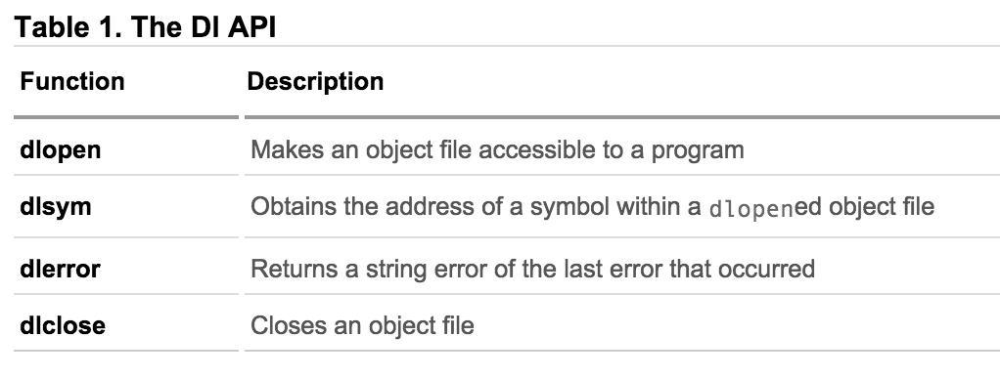
Dynamic Loading APIs

Slide 45
Using LD APIs
Opening Dynamic Library
void* sdl_library = dlopen("libSDL.so", RTLD_LAZY);
if (sdl_library == NULL) { // report error ... }
else { // use the result in a call to dlsym }
Extracting Content from Dynamic Library
void* initializer = dlsym(sdl_library,"SDL_Init");
if (initializer == NULL) { // report error ... }
else { // cast initializer to its proper type and use }
Unloading Dynamic Library
dlclose(sdl_library);

Slide 46
Week 8

Slide 47
Encryption Types
Symmetric Key Encryption
a.k.a shared secret/key
Key used to encrypt is the same as key used to decrypt
Asymmetric Key Encryption: Public/Private
2 different (but related) keys: public and private
Only creator knows the relation. Private key cannot be derived from public key
Data encrypted with public key can only be decrypted by private key and vice versa
Public key can be seen by anyone but never publish private key!!!

Slide 48
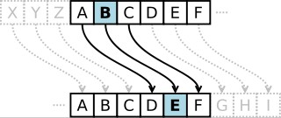
Symmetric-key Encrption
Same secret key used for encryption and decryption
Typical example: Caesar’s cipher, Data Encryption Standard (DES), Advanced Encryption Standard (AES)
Caesar's cipher
Map the alphabet to a shifted version
Key is 3 (number of shifts of the alphabet)
Key distribution is a problem
The secret key has to be delivered in a safe way to the recipient
Diffie Hellman

Slide 49
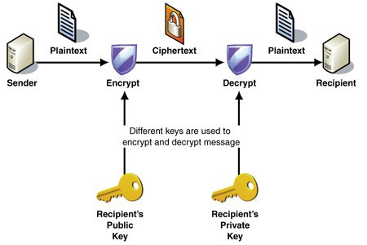
Public-key Encryption (Asymmetric)
Uses a pair of keys for encryption
Public key – Published and known to everyone
Private key – Secret key known only to the owner
Encryption
Use public key to encrypt messages
Anyone can encrypt
Decryption
Use private key to decrypt message
Example: RSA, ABE

Slide 50
Digital Signature
An electronic stamp or seal
Almost exactly like a written signature, except more guarantees!
Is appended to a message
Or sent separately (detached signature)
Ensures data integrity and authenticity
Data was not changed during transmission
Data was truly signed by the private key

Slide 51
Steps for Generating a Digital Signature
Generate a Message Digest
The message digest is generated using a set of hashing algorithms
A message digest is a 'summary' of the message we are going to transmit
Create a Digital Signature
The message digest is encrypted using the sender's private key. The resulting encrypted message digest is the digital signature
Attach digital signature to message and send to receiver
Notes:
Even the slightest change in the message produces a different digest

Slide 52
Steps for Verifying a Digital Signature
Recover the Message Digest
Decrypt the digital signature using the sender’s public key to obtain the message digest generated by the sender
Generate the Message Digest by the receiver itself
Use the same message digest algorithm used by the sender to generate a message digest of the received message
Compare digests (the one sent by the sender as a digital signature, and the one generated by the receiver)
If they are not exactly the same => the message has been tampered with by a third party

Slide 53
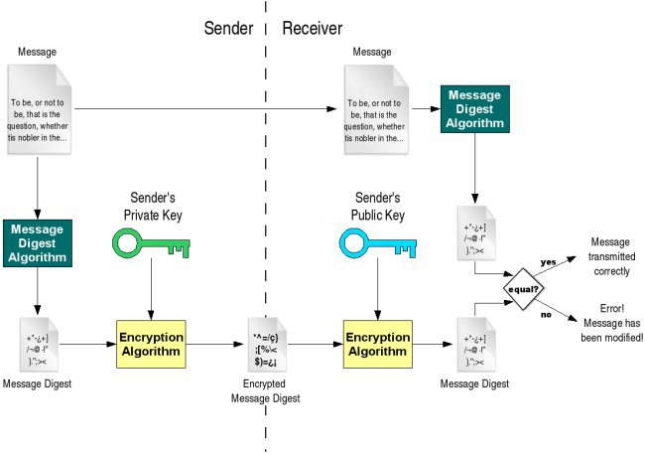
Digital Signature

Slide 54
Message Authentication Code
MAC confirms that the message came from the stated sender (its authenticity) and has not been changed (its integrity)
A strawman solution
Hash(Message)
keyed-hash message authentication code (HMAC)
A specific type of message authentication code (MAC) involving a cryptographic hash function and a secret cryptographic key
Two parties use the shared key to generate HMAC
HMAC is generated over the message and the key

Slide 55
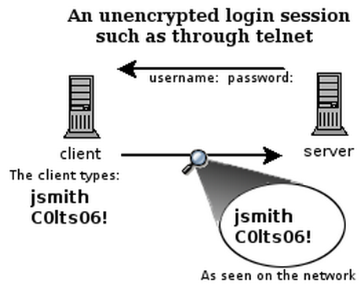
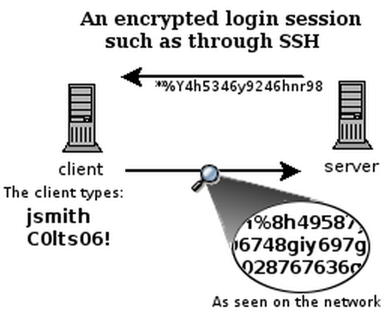
What is SSH?
Secure Shell
Used to remotely access shell
Successor of telnet
Encrypted and better authenticated session
CONFIDENTIAL

Slide 56
How does SSH work?
Based on TCP protocol (IP address + port number)
Enroll CS118 if you are not familiar with TCP/IP network
Public Key Signature to provide host authentication
Symmetric Key Encryption to ensure message confidentiality
Message Authentication Code (MAC) to ensure integrity
Password or Public Key Signature to provide user authentication

Slide 57
SSH Command
Client ssh’s to remote server
ssh connects and logs into the specified destination
Format: ssh [options] [username@]hostname
Examples
ssh 192.168.1.2
ssh root@192.168.1.2
ssh zhiyi@lnxsrv09.seas.ucla.edu
ssh -p 8022 192.168.1.2
Use the port 8022 instead of the default 22

Slide 58
First-Time SSH and Host Validation
If ssh for the first time, the host validation process will be triggered
TOFU: Trust on First Time Use.
SSH shows hostname, IP address and fingerprint of the server’s public key, so you can be sure you're talking to the correct host
The authenticity of host 'somehost (1.2.3.4)' can't be established. RSA key fingerprint is blablabla. Are you sure you want to continue connecting (yes/no)?
After accepting, the host public key is saved in ~/.ssh/known_hosts

Slide 59
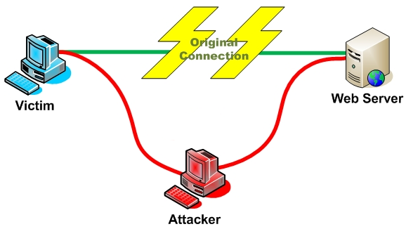
Host Validation
Next time client connects to server
Check host’s signature using the public saved
Man In The Middle (MITM) Attack?

Slide 60
Session Encryption and Data Integrity
Client and server agree on a symmetric encryption key (session key)
Diffie-Hellman
All messages sent between client and server
MAC (message authentication code) calculated
encrypted at the sender with session key
decrypted at the receiver with session key
MAC (message authentication code) verified
Anybody who doesn't know the session key doesn't know any of the contents of those messages

Slide 61
User Authentication
Password-based authentication
Prompt for password on remote server
If username specified exists and remote password for it is correct then the system lets you in
Key-based authentication
The Client side generates a digital signature using the client’s private key
The Server side verifies the signature using client’s public key
Client’s key must be known to the Server in advance

Slide 62
Week 9

Slide 63
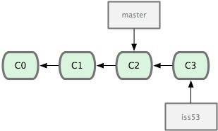
Terminologies in Git
Head
Refers to a commit object
There can be more than one heads in a repo
HEAD
Refers to the current active head
Branch
Refers to a head and its entire set of ancestor commits
Master Branch
Default branch
Detached HEAD
If a commit is not pointed to by a branch

Slide 64
Initialize a Git Repo and Add a Commit
git init
Creates an empty git repo
Creates a .git sub directory in the current dir and contains all the information of the this repo
git add .
Stage your changes
A must before a commit
git commit
Commit your staged changes to the repo and create a git commit
Commit message to let yourself/others to know the purpose and other information of your change

Slide 65
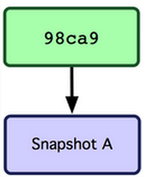
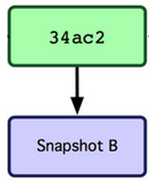
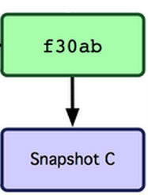
When Commit on a Branch
master

Slide 66
Get Repo From an Existing Repo
Obtain a repo from a web-based hosting service, e.g., GitHub.
git clone
Create a copy of an existing repository

Slide 67
Be Aware of Your Local Changes
git status
Show your modified files
Whether your changes have been staged or not
git diff
Show changes we made compared to the current commit and staged files
git diff HEAD
Show changes we made compared to the HEAD commit

Slide 68
Controlling Version with Branch and Tags
git checkout
Jump to the specified commit or branch or tag
Can also be used to reset the changes
git branch, git checkout -b
Create a new branch on the current commit or specified commit
git tag
Create a tag to the current commit

Slide 69
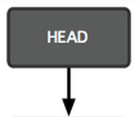
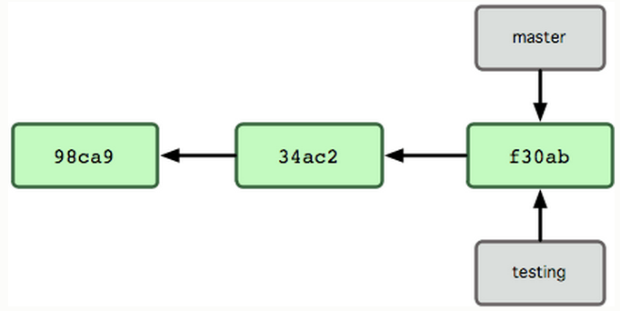
When Checkout to another Branch
git checkout testing

Slide 70
Integrating Changes
Needed when you want to integrate the changes from multiple branches
Two main ways
Merge
simple and straightforward
merge two branches into one
Rebase (recommended)
much cleaner
apply one branch’s changes onto the other branch
Some other ways, e.g., cherry-pick

